Slide 1

CS490D:
Introduction to Data Mining
Prof. Chris Clifton
March 12, 2004
Data Mining Process

Slide 2
How to Choose a Data Mining System?
Commercial data mining systems have little in common
  Different data mining functionality or methodology
  May even work with completely different kinds of data sets
Need multiple dimensional view in selection
Data types: relational, transactional, text, time sequence, spatial?
System issues
  running on only one or on several operating systems?
  a client/server architecture?
  Provide Web-based interfaces and allow XML data as input and/or output?

Slide 3
How to Choose a Data Mining System? (2)
Data sources
  ASCII text files, multiple relational data sources
  support ODBC connections (OLE DB, JDBC)?
Data mining functions and methodologies
  One vs. multiple data mining functions
  One vs. variety of methods per function
    More data mining functions and methods per function provide the user with greater flexibility and analysis power
Coupling with DB and/or data warehouse systems
  Four forms of coupling: no coupling, loose coupling, semitight coupling, and tight coupling
    Ideally, a data mining system should be tightly coupled with a database system

Slide 4
How to Choose a Data Mining System? (3)
Scalability
  Row (or database size) scalability
  Column (or dimension) scalability
  Curse of dimensionality: it is much more challenging to make a system column scalable that row scalable
Visualization tools
  “A picture is worth a thousand words”
  Visualization categories: data visualization, mining result visualization, mining process visualization, and visual data mining
Data mining query language and graphical user interface
  Easy-to-use and high-quality graphical user interface
  Essential for user-guided, highly interactive data mining

Slide 5
Examples of Data Mining Systems (1)
IBM Intelligent Miner
  A wide range of data mining algorithms
  Scalable mining algorithms
  Toolkits: neural network algorithms, statistical methods, data preparation, and data visualization tools
  Tight integration with IBM's DB2 relational database system
SAS Enterprise Miner
  A variety of statistical analysis tools
  Data warehouse tools and multiple data mining algorithms
Mirosoft SQLServer 2000
  Integrate DB and OLAP with mining
  Support OLEDB for DM standard

Slide 6
Examples of Data Mining Systems (2)
SGI MineSet
  Multiple data mining algorithms and advanced statistics
  Advanced visualization tools
Clementine (SPSS)
  An integrated data mining development environment for end-users and developers
  Multiple data mining algorithms and visualization tools
DBMiner (DBMiner Technology Inc.)
  Multiple data mining modules: discovery-driven OLAP analysis, association, classification, and clustering
  Efficient, association and sequential-pattern mining functions, and visual classification tool
  Mining both relational databases and data warehouses

Slide 7
CS490D:
Introduction to Data Mining
Prof. Chris Clifton
March 22, 2004
CRISP-DM
Thanks to Laura Squier, SPSS for some of the material used

Slide 8
SIGMOD’04 Scholarships
Want to learn more about Database and Data Mining Research?
  SIGMOD is the premier database research conference
Want $1000 off a trip to France this summer?
  June 13-18, Paris
Application Deadline March 26
  Details: http://www.cs.rpi.edu/sigmod-ugrad

Slide 9
CS490D:
Introduction to Data Mining
Prof. Chris Clifton
March 22, 2004
CRISP-DM
Thanks to Laura Squier, SPSS for some of the material used

Slide 10
Data Mining Process
Cross-Industry Standard Process for Data Mining (CRISP-DM)
European Community funded effort to develop framework for data mining tasks
Goals:
  Encourage interoperable tools across entire data mining process
  Take the mystery/high-priced expertise out of simple data mining tasks

Slide 11
Why Should There be a Standard Process?
Framework for recording experience
  Allows projects to be replicated
Aid to project planning and management
“Comfort factor” for new adopters
  Demonstrates maturity of Data Mining
  Reduces dependency on “stars”
The data mining process must be reliable and repeatable by people with little data mining background.

Slide 12
Process Standardization
CRoss Industry Standard Process for Data Mining
Initiative launched Sept.1996
SPSS/ISL, NCR, Daimler-Benz, OHRA
Funding from European commission
Over 200 members of the CRISP-DM SIG worldwide
  DM Vendors - SPSS, NCR, IBM, SAS, SGI, Data Distilleries, Syllogic, Magnify, ..
  System Suppliers / consultants - Cap Gemini, ICL Retail, Deloitte & Touche, …
  End Users - BT, ABB, Lloyds Bank, AirTouch, Experian, ...

Slide 13

CRISP-DM
Non-proprietary
Application/Industry neutral
Tool neutral
Focus on business issues
  As well as technical analysis
Framework for guidance
Experience base
  Templates for Analysis

Slide 14
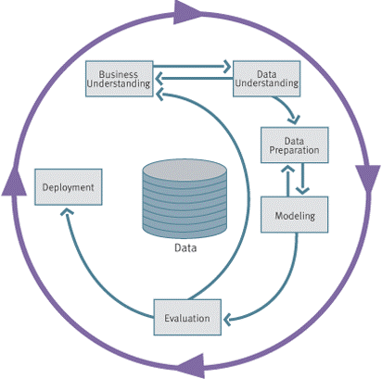
CRISP-DM: Overview

Slide 15
CRISP-DM: Phases
Business Understanding
  Understanding project objectives and requirements
  Data mining problem definition
Data Understanding
  Initial data collection and familiarization
  Identify data quality issues
  Initial, obvious results
Data Preparation
  Record and attribute selection
  Data cleansing
Modeling
  Run the data mining tools
Evaluation
  Determine if results meet business objectives
  Identify business issues that should have been addressed earlier
Deployment
  Put the resulting models into practice
  Set up for repeated/continuous mining of the data

Slide 16
Phases and Tasks
Business
Understanding
Data
Understanding
Data
Preparation
Modeling
Evaluation
Deployment
Determine
Business Objectives
Background
Business Objectives
Business Success
Criteria
Situation Assessment
Inventory of Resources
Requirements,
Assumptions, and
Constraints
Risks and Contingencies
Terminology
Costs and Benefits
Determine
Data Mining Goal
Data Mining Goals
Data Mining Success
Criteria
Produce Project Plan
Project Plan
Initial Asessment of
Tools and Techniques
Collect Initial Data
Initial Data Collection
Report
Describe Data
Data Description Report
Explore Data
Data Exploration Report
Verify Data Quality
Data Quality Report
Data Set
Data Set Description
Select Data
Rationale for Inclusion /
Exclusion
Clean Data
Data Cleaning Report
Construct Data
Derived Attributes
Generated Records
Integrate Data
Merged Data
Format Data
Reformatted Data
Select Modeling
Technique
Modeling Technique
Modeling Assumptions
Generate Test Design
Test Design
Build Model
Parameter Settings
Models
Model Description
Assess Model
Model Assessment
Revised Parameter
Settings
Evaluate Results
Assessment of Data
Mining Results w.r.t.
Business Success
Criteria
Approved Models
Review Process
Review of Process
Determine Next Steps
List of Possible Actions
Decision
Plan Deployment
Deployment Plan
Plan Monitoring and
Maintenance
Monitoring and
Maintenance Plan
Produce Final Report
Final Report
Final Presentation
Review Project
Experience
Documentation

Slide 17
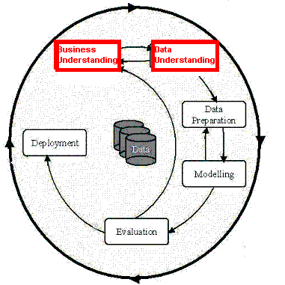
Phases in the DM Process
(1 & 2)
Business Understanding:
  Statement of Business Objective
  Statement of Data Mining objective
  Statement of Success Criteria
Data Understanding
  Explore the data and verify the quality
  Find outliers

Slide 18
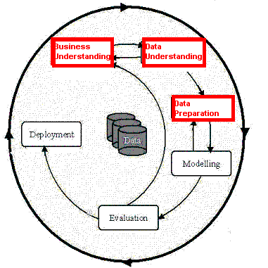
Phases in the DM Process (3)
Data preparation:
Takes usually over 90% of the time
  Collection
  Assessment
  Consolidation and Cleaning
    table links, aggregation level, missing values, etc
  Data selection
    active role in ignoring non-contributory data?
    outliers?
    Use of samples
    visualization tools
  Transformations - create new variables

Slide 19
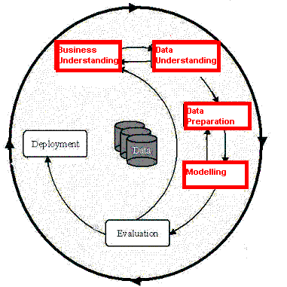
Phases in the DM Process (4)
Model building
  Selection of the modeling techniques is based upon the data mining objective
  Modeling is an iterative process - different for supervised and unsupervised learning
    May model for either description or prediction

Slide 20
Types of Models
Prediction Models for Predicting and Classifying
  Regression algorithms (predict numeric outcome): neural networks, rule induction, CART (OLS regression, GLM)
  Classification algorithm predict symbolic outcome): CHAID, C5.0 (discriminant analysis, logistic regression)
Descriptive Models for Grouping and Finding Associations
  Clustering/Grouping algorithms: K-means, Kohonen
  Association algorithms: apriori, GRI

Slide 21
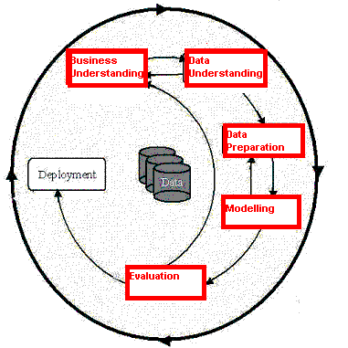
Phases in the DM Process (5)
Model Evaluation
  Evaluation of model: how well it performed on test data
  Methods and criteria depend on model type:
    e.g., coincidence matrix with classification models, mean error rate with regression models
  Interpretation of model: important or not, easy or hard depends on algorithm

Slide 22
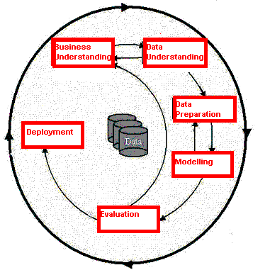
Phases in the DM Process (6)
Deployment
  Determine how the results need to be utilized
  Who needs to use them?
  How often do they need to be used
Deploy Data Mining results by:
  Scoring a database
  Utilizing results as business rules
  interactive scoring on-line

Slide 23
Why CRISP-DM?
The data mining process must be reliable and repeatable by people with little data mining skills
CRISP-DM provides a uniform framework for
  guidelines
  experience documentation
CRISP-DM is flexible to account for differences
  Different business/agency problems
  Different data

Slide 24
Concept Description: Characterization and Comparison
What is concept description?
Data generalization and summarization-based characterization
Analytical characterization: Analysis of attribute relevance
Mining class comparisons: Discriminating between different classes
Mining descriptive statistical measures in large databases
Discussion
Summary

Slide 25
What is Concept Description?
Descriptive vs. predictive data mining
  Descriptive mining: describes concepts or task-relevant data sets in concise, summarative, informative, discriminative forms
  Predictive mining: Based on data and analysis, constructs models for the database, and predicts the trend and properties of unknown data
Concept description:
  Characterization: provides a concise and succinct summarization of the given collection of data
  Comparison: provides descriptions comparing two or more collections of data

Slide 26
Concept Description vs. OLAP
Concept description:
  can handle complex data types of the attributes and their aggregations
  a more automated process
OLAP:
  restricted to a small number of dimension and measure types
  user-controlled process

Slide 27
Concept Description: Characterization and Comparison
What is concept description?
Data generalization and summarization-based characterization
Analytical characterization: Analysis of attribute relevance
Mining class comparisons: Discriminating between different classes
Mining descriptive statistical measures in large databases
Discussion
Summary

Slide 28
Data Generalization and Summarization-based Characterization
Data generalization
  A process which abstracts a large set of task-relevant data in a database from a low conceptual levels to higher ones.
  Approaches:
    Data cube approach(OLAP approach)
    Attribute-oriented induction approach
1
2
3
4
Conceptual levels
5

Slide 29
Characterization: Data Cube Approach
Data are stored in data cube
Identify expensive computations
  e.g., count( ), sum( ), average( ), max( )
Perform computations and store results in data cubes
Generalization and specialization can be performed on a data cube by roll-up and drill-down
An efficient implementation of data generalization

Slide 30
Data Cube Approach (Cont…)
Limitations
  can only handle data types of dimensions to simple nonnumeric data and of measures to simple aggregated numeric values.
  Lack of intelligent analysis, can’t tell which dimensions should be used and what levels should the generalization reach

Slide 31
CS490D:
Introduction to Data Mining
Prof. Chris Clifton
March 24, 2004
Attribute-Oriented Induction

Slide 32
Attribute-Oriented Induction
Proposed in 1989 (KDD ‘89 workshop)
Not confined to categorical data nor particular measures.
How it is done?
  Collect the task-relevant data (initial relation) using a relational database query
  Perform generalization by attribute removal or attribute generalization.
  Apply aggregation by merging identical, generalized tuples and accumulating their respective counts
  Interactive presentation with users

Slide 33
Basic Principles of Attribute-Oriented Induction
Data focusing: task-relevant data, including dimensions, and the result is the initial relation.
Attribute-removal: remove attribute A if there is a large set of distinct values for A but (1) there is no generalization operator on A, or (2) A’s higher level concepts are expressed in terms of other attributes.
Attribute-generalization: If there is a large set of distinct values for A, and there exists a set of generalization operators on A, then select an operator and generalize A.
Attribute-threshold control: typical 2-8, specified/default.
Generalized relation threshold control: control the final relation/rule size. see example

Slide 34
Attribute-Oriented Induction: Basic Algorithm
InitialRel: Query processing of task-relevant data, deriving the initial relation.
PreGen: Based on the analysis of the number of distinct values in each attribute, determine generalization plan for each attribute: removal? or how high to generalize?
PrimeGen: Based on the PreGen plan, perform generalization to the right level to derive a “prime generalized relation”, accumulating the counts.
Presentation: User interaction: (1) adjust levels by drilling, (2) pivoting, (3) mapping into rules, cross tabs, visualization presentations.

Slide 35
Example
DMQL: Describe general characteristics of graduate students in the Big-University database
  use Big_University_DB
  mine characteristics as “Science_Students”
  in relevance to name, gender, major, birth_place, birth_date, residence, phone#, gpa
  from student
  where status in “graduate”
Corresponding SQL statement:
  Select name, gender, major, birth_place, birth_date, residence, phone#, gpa
  from student
  where status in {“Msc”, “MBA”, “PhD” }

Slide 36



Class Characterization: An Example
Initial Relation
Prime Generalized Relation

Slide 37
Presentation of Generalized Results
Generalized relation:
  Relations where some or all attributes are generalized, with counts or other aggregation values accumulated.
Cross tabulation:
  Mapping results into cross tabulation form (similar to contingency tables).
  Visualization techniques:
  Pie charts, bar charts, curves, cubes, and other visual forms.
Quantitative characteristic rules:
  Mapping generalized result into characteristic rules with quantitative information associated with it, e.g.,

Slide 38
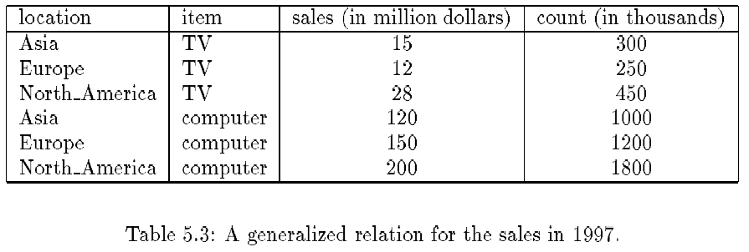
Presentation—Generalized Relation

Slide 39
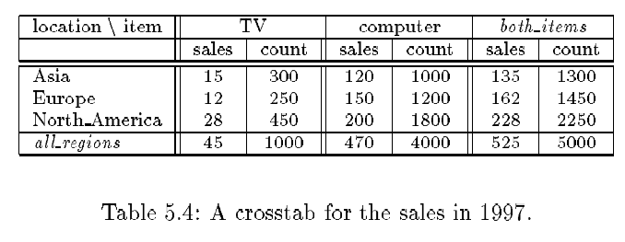
Presentation—Crosstab

Slide 40
Implementation by Cube Technology
Construct a data cube on-the-fly for the given data mining query
  Facilitate efficient drill-down analysis
  May increase the response time
  A balanced solution: precomputation of “subprime” relation
Use a predefined & precomputed data cube
  Construct a data cube beforehand
  Facilitate not only the attribute-oriented induction, but also attribute relevance analysis, dicing, slicing, roll-up and drill-down
  Cost of cube computation and the nontrivial storage overhead

Slide 41
Concept Description: Characterization and Comparison
What is concept description?
Data generalization and summarization-based characterization
Analytical characterization: Analysis of attribute relevance
Mining class comparisons: Discriminating between different classes
Mining descriptive statistical measures in large databases
Discussion
Summary

Slide 42
Characterization vs. OLAP
Similarity:
  Presentation of data summarization at multiple levels of abstraction.
  Interactive drilling, pivoting, slicing and dicing.
Differences:
  Automated desired level allocation.
  Dimension relevance analysis and ranking when there are many relevant dimensions.
  Sophisticated typing on dimensions and measures.
  Analytical characterization: data dispersion analysis.

Slide 43
Attribute Relevance Analysis
Why?
  Which dimensions should be included?
  How high level of generalization?
  Automatic VS. Interactive
  Reduce # attributes; Easy to understand patterns
What?
  statistical method for preprocessing data
    filter out irrelevant or weakly relevant attributes
    retain or rank the relevant attributes
  relevance related to dimensions and levels
  analytical characterization, analytical comparison

Slide 44
Attribute relevance analysis (cont’d)
How?
  Data Collection
  Analytical Generalization
    Use information gain analysis (e.g., entropy or other measures) to identify highly relevant dimensions and levels.
  Relevance Analysis
    Sort and select the most relevant dimensions and levels.
  Attribute-oriented Induction for class description
    On selected dimension/level
  OLAP operations (e.g. drilling, slicing) on relevance rules

Slide 45
Relevance Measures
Quantitative relevance measure determines the classifying power of an attribute within a set of data.
Methods
  information gain (ID3)
  gain ratio (C4.5)
  gini index
  χ² contingency table statistics
  uncertainty coefficient

Slide 46
Information-Theoretic Approach
Decision tree
  each internal node tests an attribute
  each branch corresponds to attribute value
  each leaf node assigns a classification
ID3 algorithm
  build decision tree based on training objects with known class labels to classify testing objects
  rank attributes with information gain measure
  minimal height
    the least number of tests to classify an object

Slide 47
Top-Down Induction of Decision Tree
Attributes = {Outlook, Temperature, Humidity, Wind}
PlayTennis = {yes, no}
Outlook
sunny
rain
overcast
Humidity
Wind
yes
high
normal
strong
weak
no
yes
no
yes

Slide 48
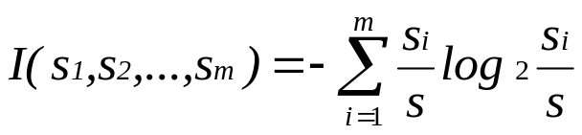
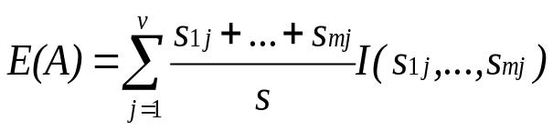

Entropy and Information Gain
S contains s_{i} tuples of class C_{i} for i = {1, …, m}
Information measures info required to classify any arbitrary tuple
Entropy of attribute A with values {a₁,a₂,…,a_{v}}
Information gained by branching on attribute A

Slide 49
Example: Analytical Characterization
Task
  Mine general characteristics describing graduate students using analytical characterization
Given
  attributes name, gender, major, birth_place, birth_date, phone#, and gpa
  Gen(a_{i}) = concept hierarchies on a_{i}
  U_{i} = attribute analytical thresholds for a_{i}
  T_{i} = attribute generalization thresholds for a_{i}
  R = attribute relevance threshold

Slide 50
Example: Analytical Characterization (cont’d)
1. Data collection
  target class: graduate student
  contrasting class: undergraduate student
2. Analytical generalization using U_{i}
  attribute removal
    remove name and phone#
  attribute generalization
    generalize major, birth_place, birth_date and gpa
    accumulate counts
  candidate relation: gender, major, birth_country, age_range and gpa

Slide 51
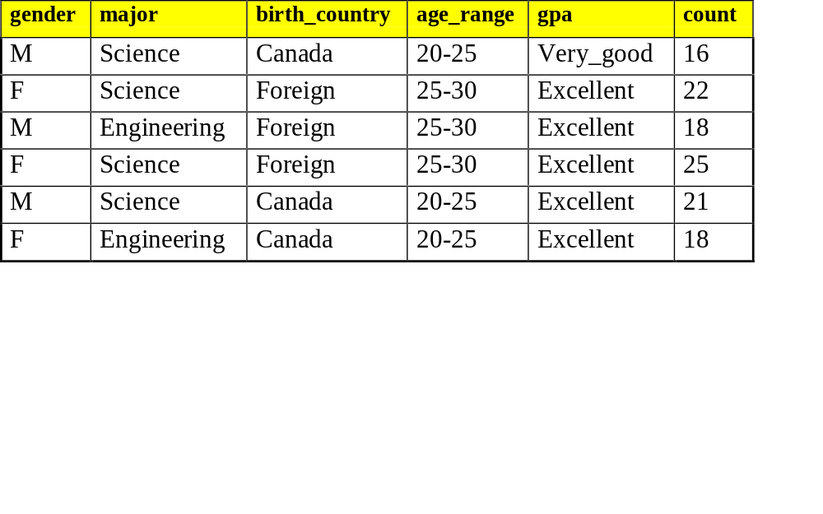
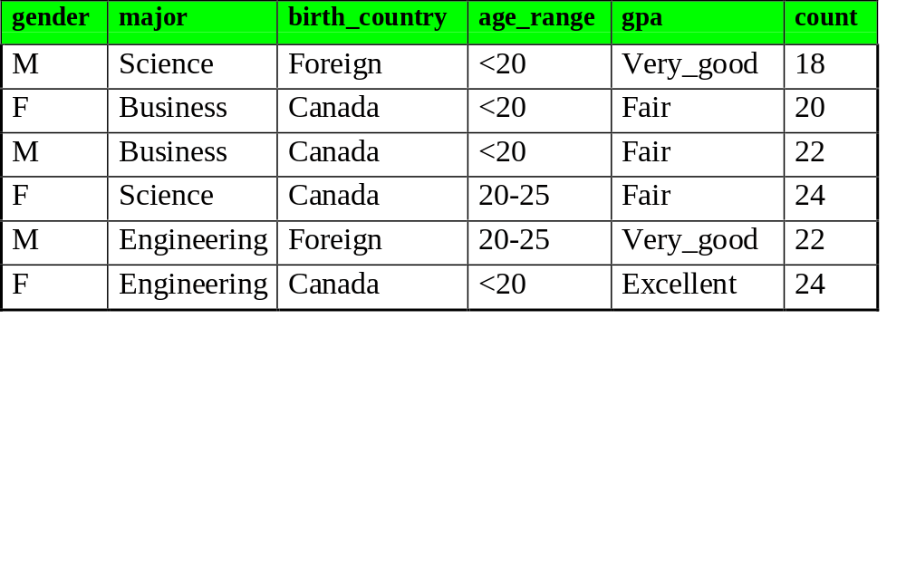
Example: Analytical characterization (2)
Candidate relation for Target class: Graduate students (Σ=120)
Candidate relation for Contrasting class: Undergraduate students (Σ=130)

Slide 52
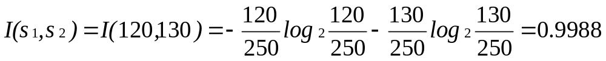
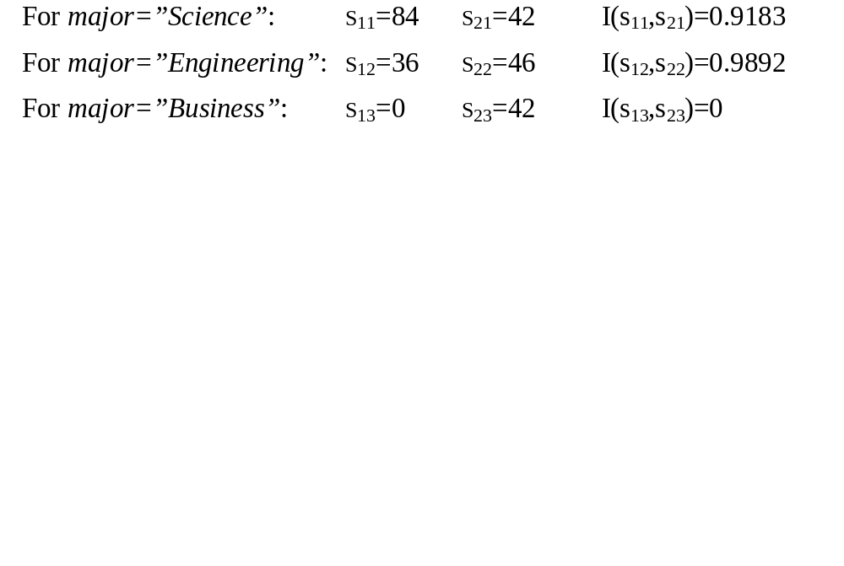
Example: Analytical characterization (3)
3. Relevance analysis
  Calculate expected info required to classify an arbitrary tuple
  Calculate entropy of each attribute: e.g. major
Number of grad students in “Science”
Number of undergrad students in “Science”

Slide 53
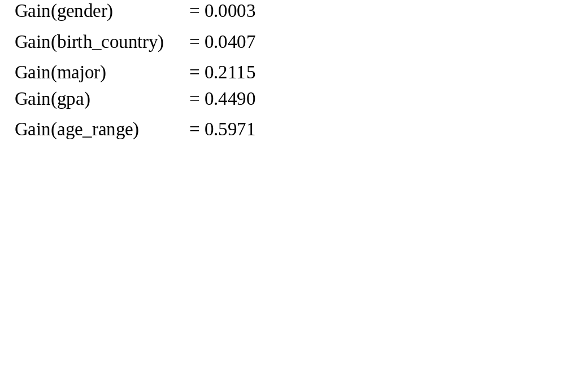
Example: Analytical Characterization (4)
Calculate expected info required to classify a given sample if S is partitioned according to the attribute
Calculate information gain for each attribute
  Information gain for all attributes

Slide 54
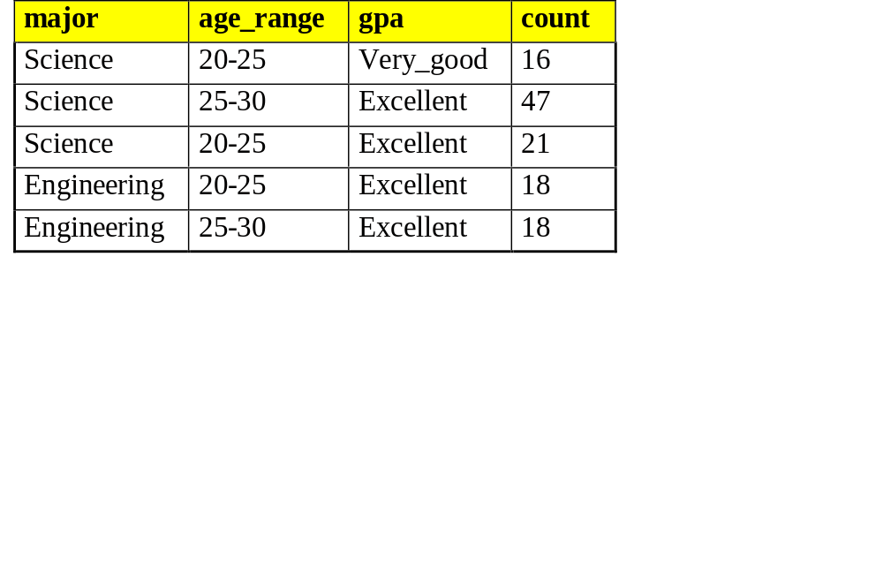
Example: Analytical characterization (5)
4. Initial working relation (W₀) derivation
  R = 0.1
  remove irrelevant/weakly relevant attributes from candidate relation => drop gender, birth_country
  remove contrasting class candidate relation
5. Perform attribute-oriented induction on W₀ using T_{i}
Initial target class working relation W₀: Graduate students

Slide 55
Concept Description: Characterization and Comparison
What is concept description?
Data generalization and summarization-based characterization
Analytical characterization: Analysis of attribute relevance
Mining class comparisons: Discriminating between different classes
Mining descriptive statistical measures in large databases
Discussion
Summary

Slide 56
Mining Class Comparisons
Comparison: Comparing two or more classes
Method:
  Partition the set of relevant data into the target class and the contrasting class(es)
  Generalize both classes to the same high level concepts
  Compare tuples with the same high level descriptions
  Present for every tuple its description and two measures
    support - distribution within single class
    comparison - distribution between classes
  Highlight the tuples with strong discriminant features
Relevance Analysis:
  Find attributes (features) which best distinguish different classes

Slide 57
Example: Analytical comparison
Task
  Compare graduate and undergraduate students using discriminant rule.
  DMQL query
use Big_University_DB
mine comparison as “grad_vs_undergrad_students”
in relevance to name, gender, major, birth_place, birth_date, residence, phone#, gpa
for “graduate_students”
where status in graduate”
versus “undergraduate_students”
where status in “undergraduate”
analyze count%
from student

Slide 58
Example: Analytical comparison (2)
Given
  attributes name, gender, major, birth_place, birth_date, residence, phone# and gpa
  Gen(a_{i}) = concept hierarchies on attributes a_{i}
  U_{i} = attribute analytical thresholds for attributes a_{i}
  T_{i} = attribute generalization thresholds for attributes a_{i}
  R = attribute relevance threshold

Slide 59
Example: Analytical comparison (3)
1. Data collection
  target and contrasting classes
2. Attribute relevance analysis
  remove attributes name, gender, major, phone#
3. Synchronous generalization
  controlled by user-specified dimension thresholds
  prime target and contrasting class(es) relations/cuboids

Slide 60
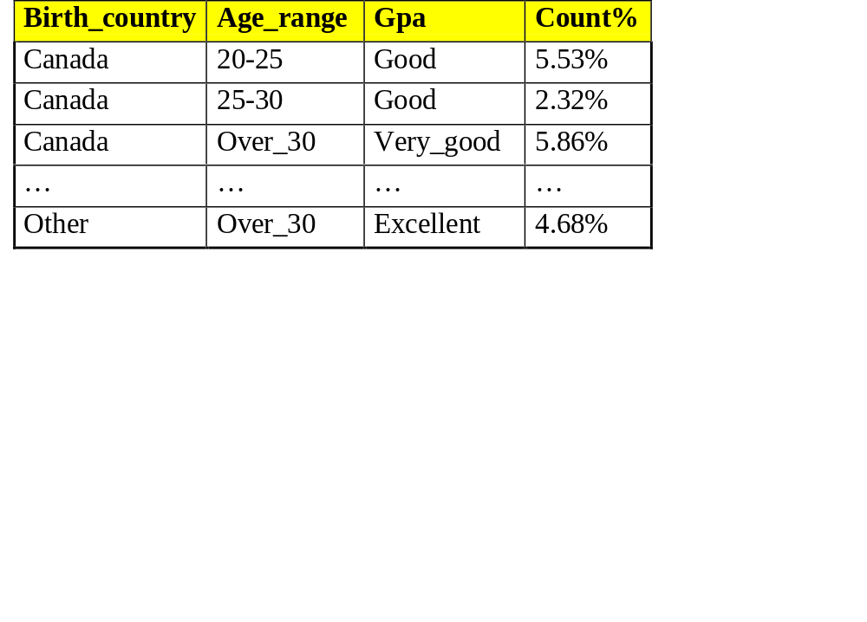
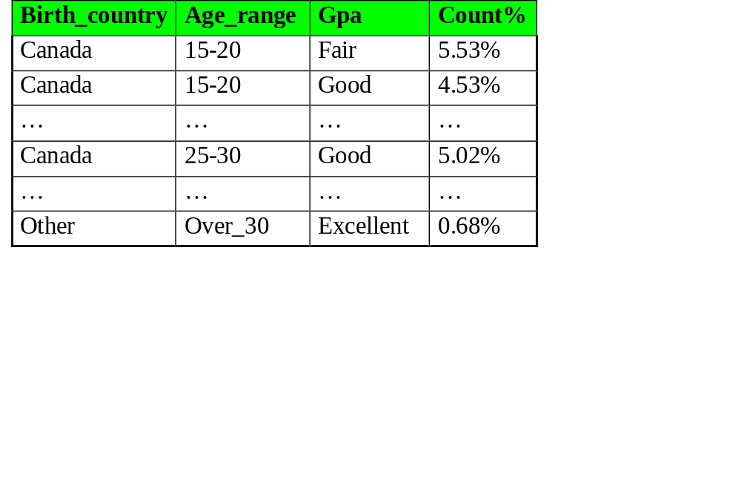
Example: Analytical comparison (4)
Prime generalized relation for the target class: Graduate students
Prime generalized relation for the contrasting class: Undergraduate students

Slide 61
Example: Analytical comparison (5)
4. Drill down, roll up and other OLAP operations on target and contrasting classes to adjust levels of abstractions of resulting description
5. Presentation
  as generalized relations, crosstabs, bar charts, pie charts, or rules
  contrasting measures to reflect comparison between target and contrasting classes
    e.g. count%

Slide 62
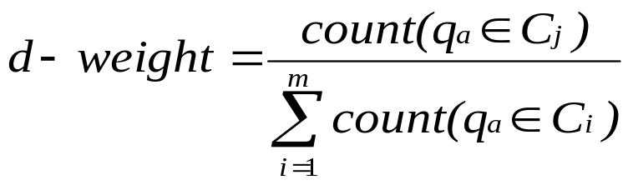
Quantitative Discriminant Rules
Cj = target class
q_{a} = a generalized tuple covers some tuples of class
  but can also cover some tuples of contrasting class
d-weight
  range: [0, 1]
quantitative discriminant rule form

Slide 63
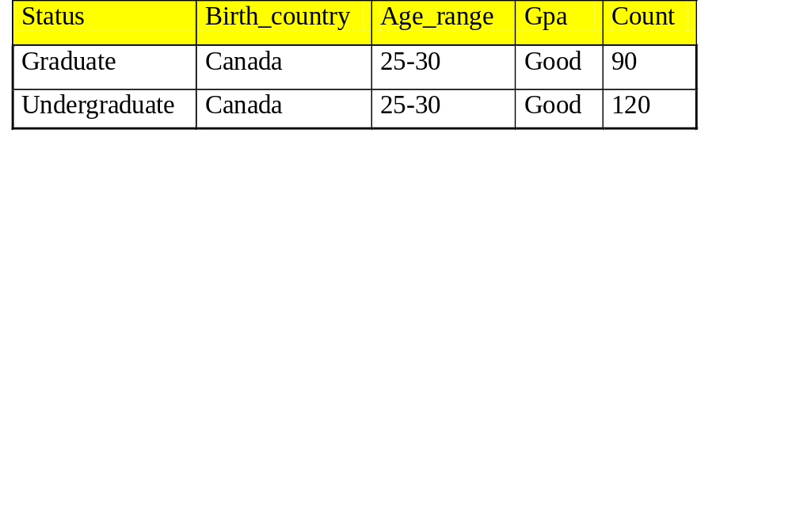
Example: Quantitative Discriminant Rule
Count distribution between graduate and undergraduate students for a generalized tuple
Quantitative discriminant rule
  where 90/(90+120) = 30%

Slide 64
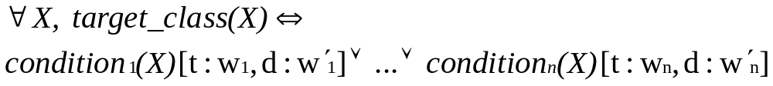
Class Description
Quantitative characteristic rule
  necessary
Quantitative discriminant rule
  sufficient
Quantitative description rule
  necessary and sufficient

Slide 65
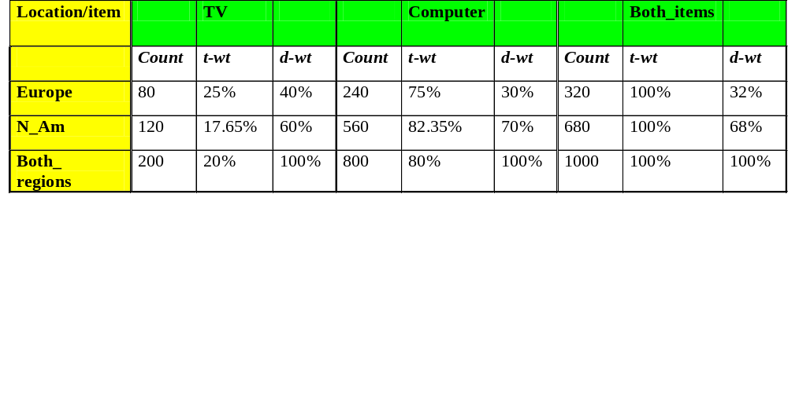
Example: Quantitative Description Rule
Crosstab showing associated t-weight, d-weight values and total number (in thousands) of TVs and computers sold at AllElectronics in 1998
Quantitative description rule for target class Europe

Slide 66
Mining Complex Data Objects: Generalization of Structured Data
Set-valued attribute
  Generalization of each value in the set into its corresponding higher-level concepts
  Derivation of the general behavior of the set, such as the number of elements in the set, the types or value ranges in the set, or the weighted average for numerical data
  E.g., hobby = {tennis, hockey, chess, violin, nintendo_games} generalizes to {sports, music, video_games}
List-valued or a sequence-valued attribute
  Same as set-valued attributes except that the order of the elements in the sequence should be observed in the generalization

Slide 67
Generalizing Spatial and Multimedia Data
Spatial data:
  Generalize detailed geographic points into clustered regions, such as business, residential, industrial, or agricultural areas, according to land usage
  Require the merge of a set of geographic areas by spatial operations
Image data:
  Extracted by aggregation and/or approximation
  Size, color, shape, texture, orientation, and relative positions and structures of the contained objects or regions in the image
Music data:
  Summarize its melody: based on the approximate patterns that repeatedly occur in the segment
  Summarized its style: based on its tone, tempo, or the major musical instruments played

Slide 68
Generalizing Object Data
Object identifier: generalize to the lowest level of class in the class/subclass hierarchies
Class composition hierarchies
  generalize nested structured data
  generalize only objects closely related in semantics to the current one
Construction and mining of object cubes
  Extend the attribute-oriented induction method
    Apply a sequence of class-based generalization operators on different attributes
    Continue until getting a small number of generalized objects that can be summarized as a concise in high-level terms
  For efficient implementation
    Examine each attribute, generalize it to simple-valued data
    Construct a multidimensional data cube (object cube)
    Problem: it is not always desirable to generalize a set of values to single-valued data

Slide 69
An Example: Plan Mining by Divide & Conquer
Plan: a variable sequence of actions
  E.g., Travel (flight): <traveler, departure, arrival, d-time, a-time, airline, price, seat>
Plan mining: extraction of important or significant generalized (sequential) patterns from a planbase (a large collection of plans)
  E.g., Discover travel patterns in an air flight database, or
  find significant patterns from the sequences of actions in the repair of automobiles
Method
  Attribute-oriented induction on sequence data
    A generalized travel plan: <small-big*-small>
  Divide & conquer:Mine characteristics for each subsequence
    E.g., big*: same airline, small-big: nearby region

Slide 70
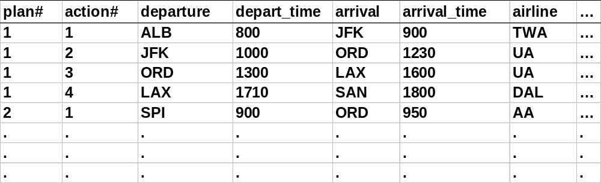
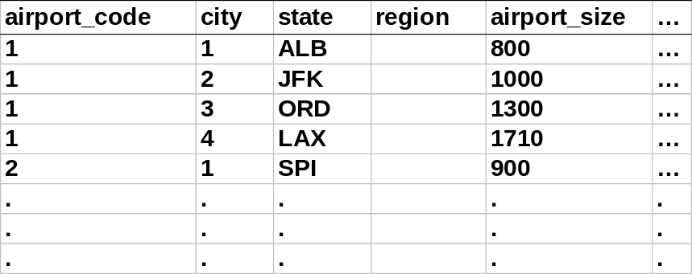
A Travel Database for Plan Mining
Example: Mining a travel planbase
Travel plans table
Airport info table

Slide 71
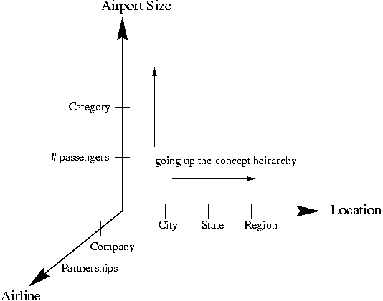
Multidimensional Analysis
Strategy
  Generalize the planbase in different directions
  Look for sequential patterns in the generalized plans
  Derive high-level plans
A multi-D model for the planbase

Slide 72
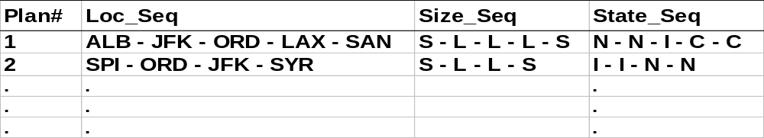
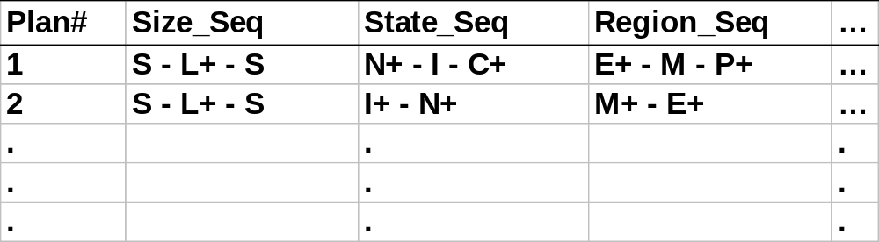
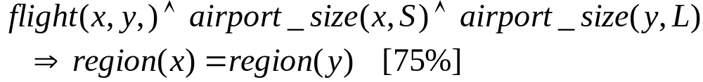
Multidimensional Generalization
Multi-D generalization of the planbase
Merging consecutive, identical actions in plans

Slide 73
Generalization-Based Sequence Mining
Generalize planbase in multidimensional way using dimension tables
Use # of distinct values (cardinality) at each level to determine the right level of generalization (level-“planning”)
Use operators merge “+”, option “[]” to further generalize patterns
Retain patterns with significant support

Slide 74
Generalized Sequence Patterns
AirportSize-sequence survives the min threshold (after applying merge operator):
  S-L⁺-S [35%], L⁺-S [30%], S-L⁺ [24.5%], L⁺ [9%]
After applying option operator:
  [S]-L⁺-[S] [98.5%]
  Most of the time, people fly via large airports to get to final destination
Other plans: 1.5% of chances, there are other patterns: S-S, L-S-L

Slide 75
Concept Description: Characterization and Comparison
What is concept description?
Data generalization and summarization-based characterization
Analytical characterization: Analysis of attribute relevance
Mining class comparisons: Discriminating between different classes
Mining descriptive statistical measures in large databases
Discussion
Summary

Slide 76
Mining Data Dispersion Characteristics
Motivation
  To better understand the data: central tendency, variation and spread
Data dispersion characteristics
  median, max, min, quantiles, outliers, variance, etc.
Numerical dimensions correspond to sorted intervals
  Data dispersion: analyzed with multiple granularities of precision
  Boxplot or quantile analysis on sorted intervals
Dispersion analysis on computed measures
  Folding measures into numerical dimensions
  Boxplot or quantile analysis on the transformed cube

Slide 77
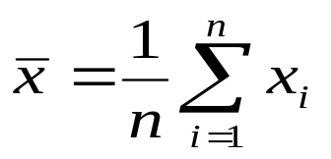

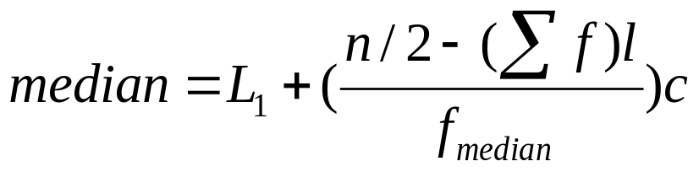
Measuring the Central Tendency
Mean
  Weighted arithmetic mean
Median: A holistic measure
  Middle value if odd number of values, or average of the middle two values otherwise
  estimated by interpolation
Mode
  Value that occurs most frequently in the data
  Unimodal, bimodal, trimodal
  Empirical formula:

Slide 78
Measuring the Dispersion of Data
Quartiles, outliers and boxplots
  Quartiles: Q₁ (25th percentile), Q₃ (75th percentile)
  Inter-quartile range: IQR = Q₃ – Q₁
  Five number summary: min, Q₁, M, Q₃, max
  Boxplot: ends of the box are the quartiles, median is marked, whiskers, and plot outlier individually
  Outlier: usually, a value higher/lower than 1.5 x IQR
Variance and standard deviation
  Variance s²: (algebraic, scalable computation)
  Standard deviation s is the square root of variance s²

Slide 79

Boxplot Analysis
Five-number summary of a distribution:
  Minimum, Q1, M, Q3, Maximum
Boxplot
  Data is represented with a box
  The ends of the box are at the first and third quartiles, i.e., the height of the box is IRQ
  The median is marked by a line within the box
  Whiskers: two lines outside the box extend to Minimum and Maximum

Slide 80

Visualization of Data Dispersion: Boxplot Analysis

Slide 81
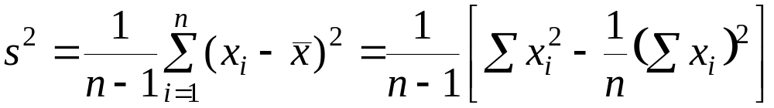
Mining Descriptive Statistical Measures in Large Databases
Variance
Standard deviation: the square root of the variance
  Measures spread about the mean
  It is zero if and only if all the values are equal
  Both the deviation and the variance are algebraic

Slide 82

Histogram Analysis
Graph displays of basic statistical class descriptions
  Frequency histograms
    A univariate graphical method
    Consists of a set of rectangles that reflect the counts or frequencies of the classes present in the given data

Slide 83
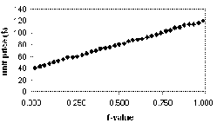
Quantile Plot
Displays all of the data (allowing the user to assess both the overall behavior and unusual occurrences)
Plots quantile information
  For a data x_{i} data sorted in increasing order, f_{i} indicates that approximately 100 f_{i}% of the data are below or equal to the value x_{i}

Slide 84
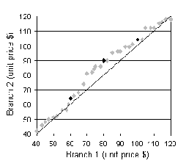
Quantile-Quantile (Q-Q) Plot
Graphs the quantiles of one univariate distribution against the corresponding quantiles of another
Allows the user to view whether there is a shift in going from one distribution to another

Slide 85
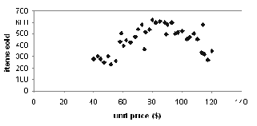
Scatter plot
Provides a first look at bivariate data to see clusters of points, outliers, etc
Each pair of values is treated as a pair of coordinates and plotted as points in the plane

Slide 86
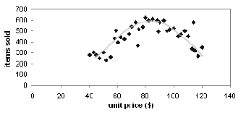
Loess Curve
Adds a smooth curve to a scatter plot in order to provide better perception of the pattern of dependence
Loess curve is fitted by setting two parameters: a smoothing parameter, and the degree of the polynomials that are fitted by the regression

Slide 87
Graphic Displays of Basic Statistical Descriptions
Histogram: (shown before)
Boxplot: (covered before)
Quantile plot: each value x_{i} is paired with f_{i} indicating that approximately 100 f_{i} % of data are ≤ x_{i}
Quantile-quantile (q-q) plot: graphs the quantiles of one univariant distribution against the corresponding quantiles of another
Scatter plot: each pair of values is a pair of coordinates and plotted as points in the plane
Loess (local regression) curve: add a smooth curve to a scatter plot to provide better perception of the pattern of dependence

Slide 88
Concept Description: Characterization and Comparison
What is concept description?
Data generalization and summarization-based characterization
Analytical characterization: Analysis of attribute relevance
Mining class comparisons: Discriminating between different classes
Mining descriptive statistical measures in large databases
Discussion
Summary

Slide 89
AO Induction vs. Learning-from-example Paradigm
Difference in philosophies and basic assumptions
  Positive and negative samples in learning-from-example: positive used for generalization, negative - for specialization
  Positive samples only in data mining: hence generalization-based, to drill-down backtrack the generalization to a previous state
Difference in methods of generalizations
  Machine learning generalizes on a tuple by tuple basis
  Data mining generalizes on an attribute by attribute basis

Slide 90
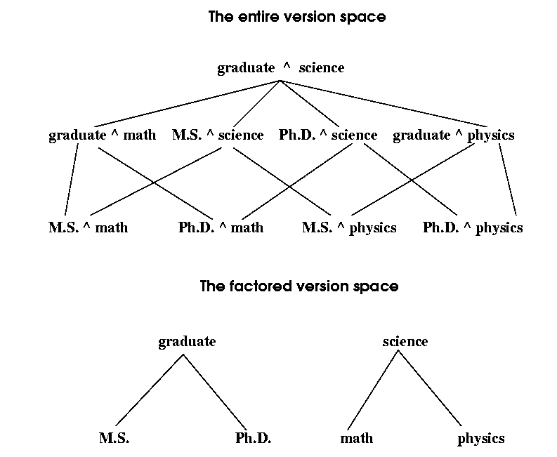
Entire vs. Factored Version Space

Slide 91
Incremental and Parallel Mining of Concept Description
Incremental mining: revision based on newly added data ΔDB
  Generalize ΔDB to the same level of abstraction in the generalized relation R to derive ΔR
  Union R U ΔR, i.e., merge counts and other statistical information to produce a new relation R’
Similar philosophy can be applied to data sampling, parallel and/or distributed mining, etc.

Slide 92
Concept Description: Characterization and Comparison
What is concept description?
Data generalization and summarization-based characterization
Analytical characterization: Analysis of attribute relevance
Mining class comparisons: Discriminating between different classes
Mining descriptive statistical measures in large databases
Discussion
Summary

Slide 93
Summary
Concept description: characterization and discrimination
OLAP-based vs. attribute-oriented induction
Efficient implementation of AOI
Analytical characterization and comparison
Mining descriptive statistical measures in large databases
Discussion
  Incremental and parallel mining of description
  Descriptive mining of complex types of data

Slide 94
References
Y. Cai, N. Cercone, and J. Han. Attribute-oriented induction in relational databases. In G. Piatetsky-Shapiro and W. J. Frawley, editors, Knowledge Discovery in Databases, pages 213-228. AAAI/MIT Press, 1991.
S. Chaudhuri and U. Dayal. An overview of data warehousing and OLAP technology. ACM SIGMOD Record, 26:65-74, 1997
C. Carter and H. Hamilton. Efficient attribute-oriented generalization for knowledge discovery from large databases. IEEE Trans. Knowledge and Data Engineering, 10:193-208, 1998.
W. Cleveland. Visualizing Data. Hobart Press, Summit NJ, 1993.
J. L. Devore. Probability and Statistics for Engineering and the Science, 4th ed. Duxbury Press, 1995.
T. G. Dietterich and R. S. Michalski. A comparative review of selected methods for learning from examples. In Michalski et al., editor, Machine Learning: An Artificial Intelligence Approach, Vol. 1, pages 41-82. Morgan Kaufmann, 1983.
J. Gray, S. Chaudhuri, A. Bosworth, A. Layman, D. Reichart, M. Venkatrao, F. Pellow, and H. Pirahesh. Data cube: A relational aggregation operator generalizing group-by, cross-tab and sub-totals. Data Mining and Knowledge Discovery, 1:29-54, 1997.
J. Han, Y. Cai, and N. Cercone. Data-driven discovery of quantitative rules in relational databases. IEEE Trans. Knowledge and Data Engineering, 5:29-40, 1993.

Slide 95
References (cont.)
J. Han and Y. Fu. Exploration of the power of attribute-oriented induction in data mining. In U.M. Fayyad, G. Piatetsky-Shapiro, P. Smyth, and R. Uthurusamy, editors, Advances in Knowledge Discovery and Data Mining, pages 399-421. AAAI/MIT Press, 1996.
R. A. Johnson and D. A. Wichern. Applied Multivariate Statistical Analysis, 3rd ed. Prentice Hall, 1992.
E. Knorr and R. Ng. Algorithms for mining distance-based outliers in large datasets. VLDB'98, New York, NY, Aug. 1998.
H. Liu and H. Motoda. Feature Selection for Knowledge Discovery and Data Mining. Kluwer Academic Publishers, 1998.
R. S. Michalski. A theory and methodology of inductive learning. In Michalski et al., editor, Machine Learning: An Artificial Intelligence Approach, Vol. 1, Morgan Kaufmann, 1983.
T. M. Mitchell. Version spaces: A candidate elimination approach to rule learning. IJCAI'97, Cambridge, MA.
T. M. Mitchell. Generalization as search. Artificial Intelligence, 18:203-226, 1982.
T. M. Mitchell. Machine Learning. McGraw Hill, 1997.
J. R. Quinlan. Induction of decision trees. Machine Learning, 1:81-106, 1986.
D. Subramanian and J. Feigenbaum. Factorization in experiment generation. AAAI'86, Philadelphia, PA, Aug. 1986.

